Slide 1
Bitcoin Mechanics
cryptography in bitcoin

Slide 2
outline
DH Key Exchange
RSA
ECC

Slide 3
Why encryption is needed?
Name scenarios where encryption is used
Name a few symmetric encryption algorithm
Name the situation where symmetric key sharing is improbable

Slide 4



Caesar Cipher
Encryption:
Decryption:

Slide 5
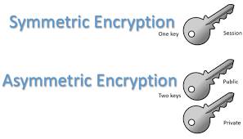
Symmetric vs Asymmetric
Keys:

Slide 6
Symmetric and asymmetric-key cryptography
Symmetric and asymmetric-key cryptography will exist in parallel and continue to serve the community. We actually believe that they are complements of each other; the advantages of one can compensate for the disadvantages of the other.

Slide 7
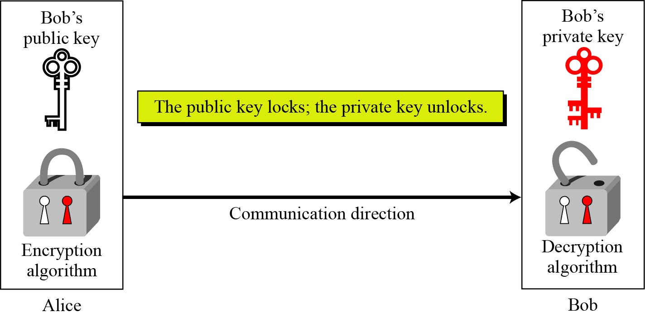
Asymmetric key cryptography uses two separate keys: one private and one public.
Locking and unlocking in asymmetric-key cryptosystem

Slide 8
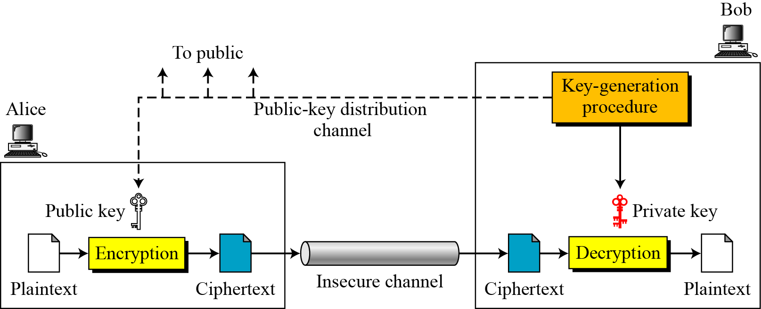
General idea of asymmetric-key cryptosystem

Slide 9
Plaintext/Ciphertext
Unlike in symmetric-key cryptography, plaintext and ciphertext are treated as integers in asymmetric-key cryptography.
Encryption/Decryption
C = e(K_{public} , P) P = d(K_{private} , C)

Slide 10
There is a very important fact that is sometimes misunderstood: The advent of asymmetric-key cryptography DOES NOT eliminate the need for symmetric-key cryptography.

Slide 11
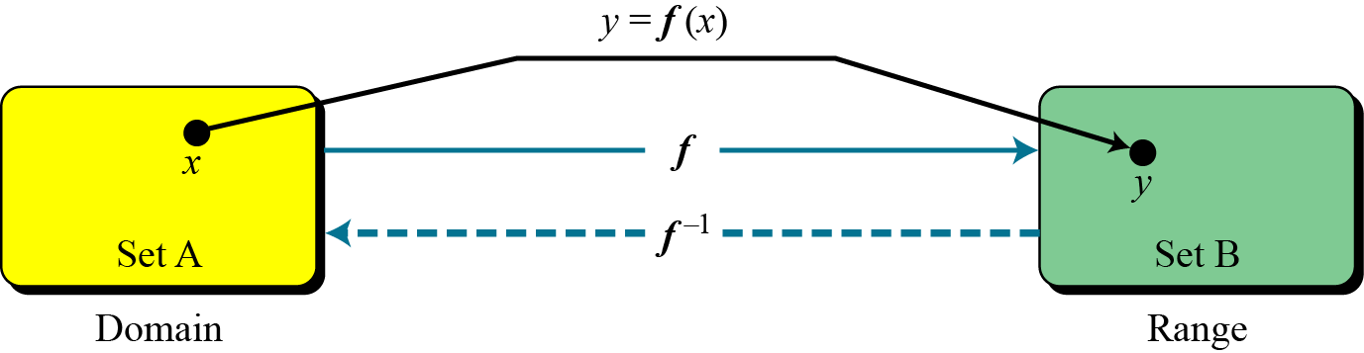
The main idea behind asymmetric-key cryptography is the concept of the trapdoor one-way function.
Functions
A function as rule mapping a domain to a range

Slide 12
One-Way Function (OWF)
1. f is easy to compute.
2. f ⁻¹ is difficult to compute.
Trapdoor One-Way Function (TOWF)
3. Given y and a trapdoor, x can be computed easily.

Slide 13
When n is large, n = p × q is a one-way function.
Easy Given p and q → calculate n
Difficult Given n → calculate p and q
This is the factorization problem.
When n is large, the function y = x^{k} mod n is a trapdoor one-way function.
Easy Given x, k, and n → calculate y
Difficult Given y, k, and n → calculate x
This is the discrete logarithm problem.
However, if we know the trapdoor, k′ such that k × k ′ = 1 mod φ(n), we can use x = y^{k′} mod n to find x.

Slide 14

Diffie-Hellman Key Exchange

Slide 15
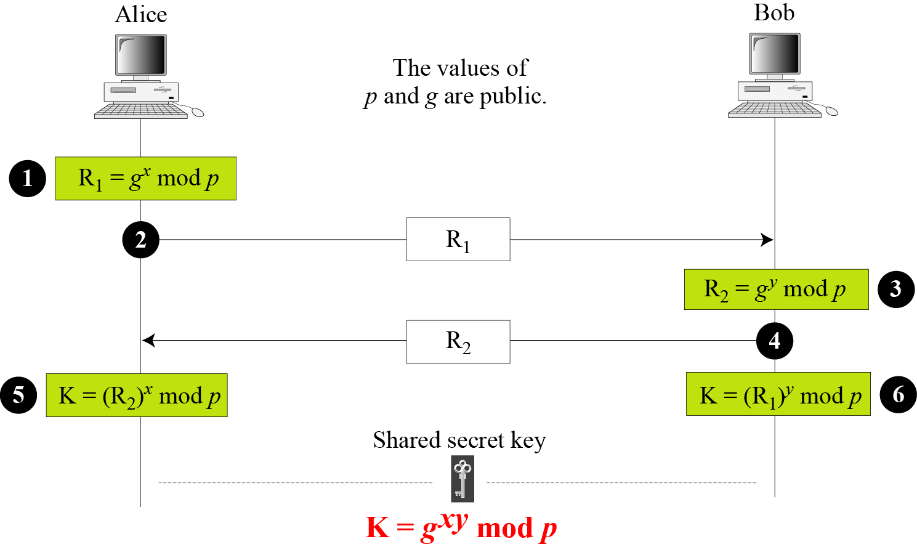
Diffie-Hellman Key Agreement
Secret x
Secret y

Slide 16
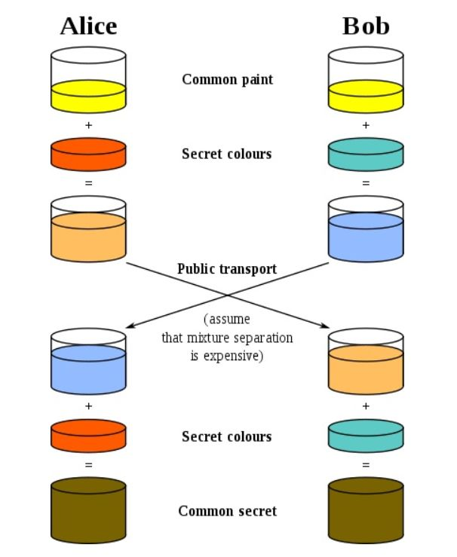
Analog
Alice & Bob each think of a secret color (known only to them)
They mix their color with yellow (agreed upon openly ahead of time) and exchange.
They mix their color with what they’ve received.
Both have the same color but observer cannot duplicate.

Slide 17

Note
The symmetric (shared) key in the Diffie-Hellman method is K = g^{xy} mod p.

Slide 18
Example
Let us give a trivial example to make the procedure clear. Our example uses small numbers, but note that in a real situation, the numbers are very large. Assume that g = 7 and p = 23. The steps are as follows:
Alice chooses x = 3 and calculates R₁ = 7^3 mod 23 = 21.
Bob chooses y = 6 and calculates R₂ = 7^6 mod 23 = 4.
Alice sends the number 21 to Bob.
Bob sends the number 4 to Alice.
Alice calculates the symmetric key K = 4^3 mod 23 = 18.
Bob calculates the symmetric key K = 21^6 mod 23 = 18.
The value of K is the same for both Alice and Bob; g^{xy} mod p = 7^18 mod 23 = 18.

Slide 19
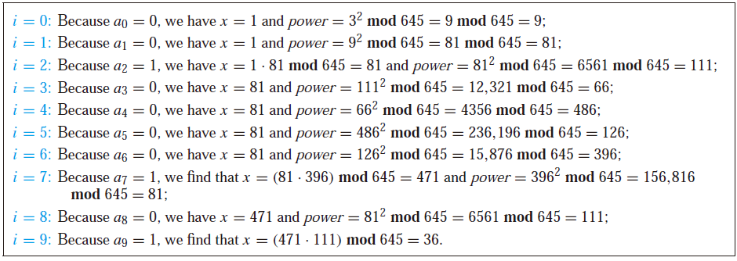
Example: 3⁶⁴⁴ mod 645
Note: 644 = (1010000100)₂
Steps performed by the algorithm:
Aside: 3⁶⁴⁴ is HUGE but final
answer between 0 and 644. ☺
So , 3⁶⁴⁴ mod 645 = 36.
Key point: you compute successive powers but numbers
stay small because of repeated Mod operation!

Slide 20
Example
Let us give a more realistic example. We used a program to create a random integer of 512 bits (the ideal is 1024 bits). The integer p is a 159-digit number. We also choose g, x, and y as shown below:

Slide 21
Example 15.2
The following shows the values of R₁, R₂, and K.

Slide 22
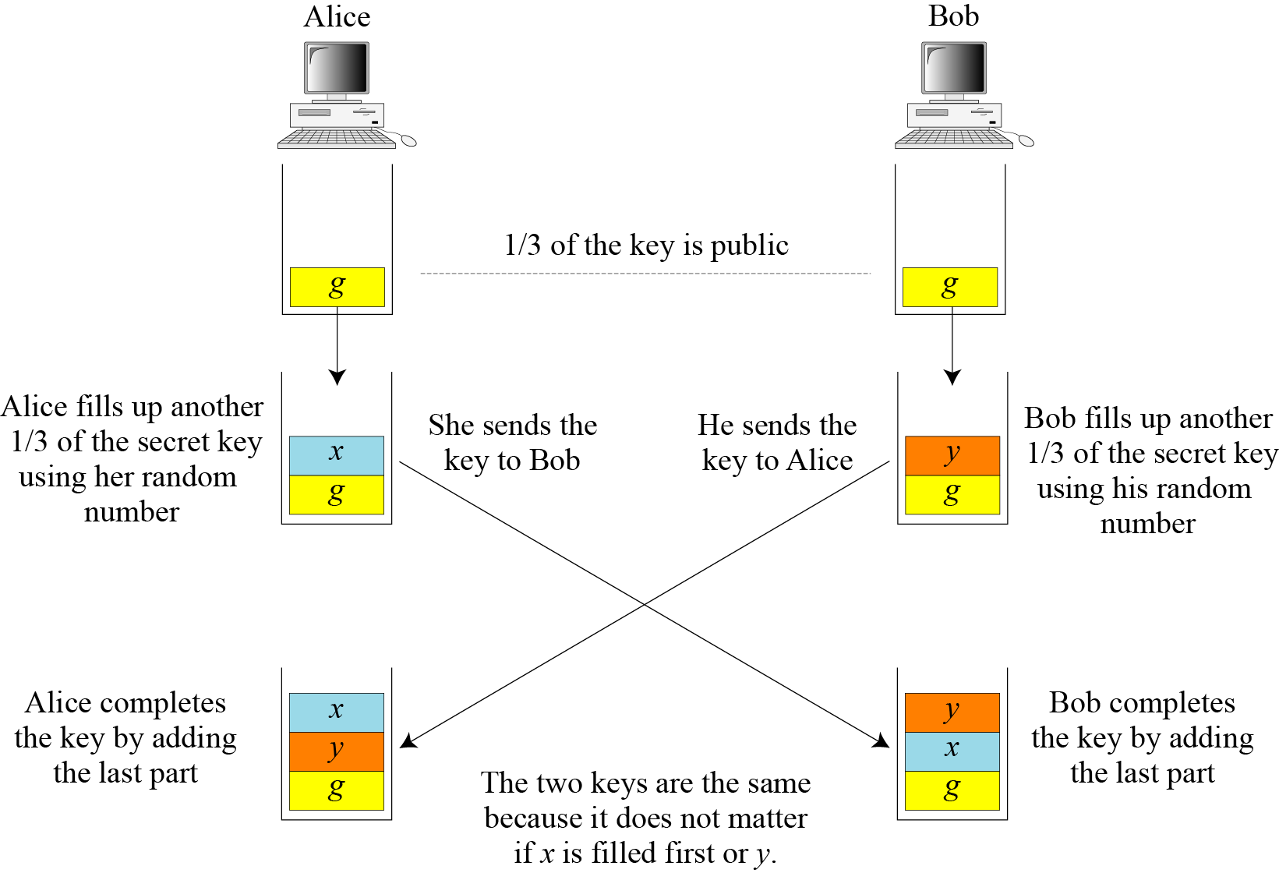

Slide 23
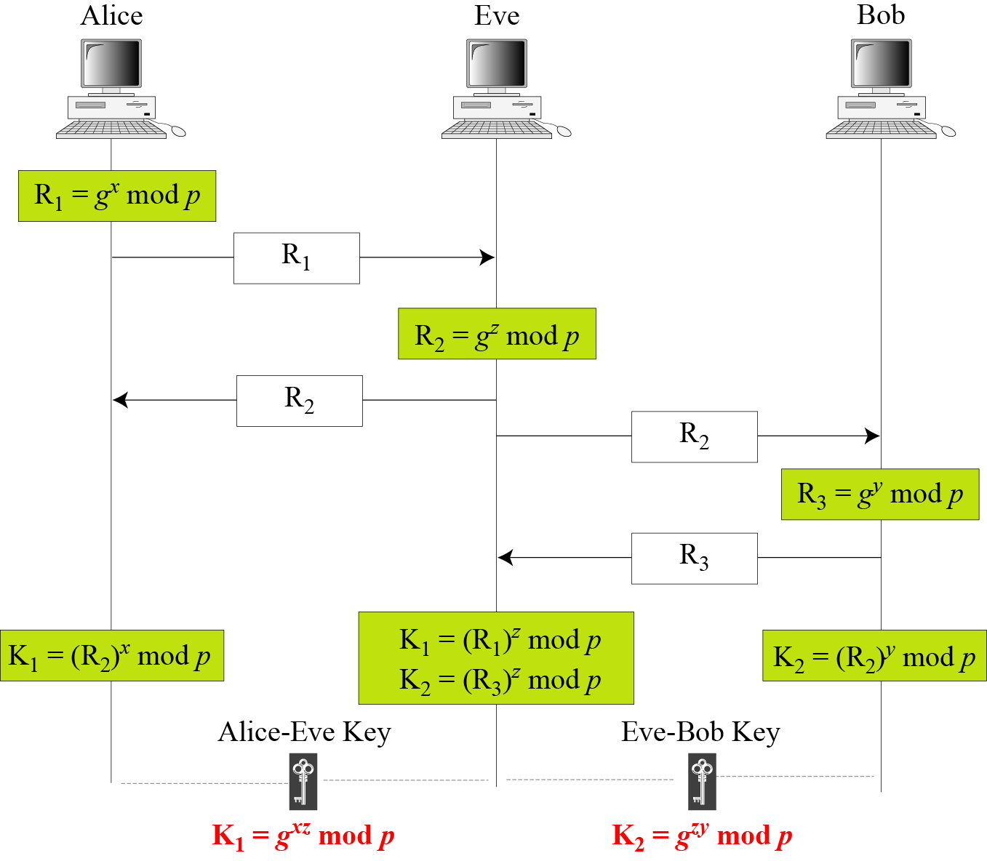
Man-in-the-Middle Attack

Slide 24
RSA CRYPTOSYSTEM
The most common public-key algorithm is the RSA cryptosystem, named for its inventors (Rivest, Shamir, and Adleman).

Slide 25
RSA Cryptography
There are several encryption methods. Perhaps the simplest “unbreakable” system is the RSA (Rivest, Shamir, Adleman) system. FrogsRUs.com provides a large number N (e.g. 1024 bit binary number) and an encryption exponent e. Usually the server communicates these directly to web browser behind the scenes.
N, e
Frogs 'R Us

Slide 26
RSA Cryptography
Mr. Smiley’s browser then converts his message into numbers.
The letters are then put together into number blocks with each block less than N.Mr. Smiley’s browser exponentiates each number block by the exponent e modulo N and broadcasts these garbled blocks back to FrogsRUs.com
☺

Slide 27
RSA Cryptography
☺
m ^{e} mod N
N = 4559, e = 13.
Smiley Transmits: “Last name Smiley”
Notes:
N = 97·47
Convert white space to 00

Slide 28
RSA Cryptography
☺
m ^{e} mod N
N = 4559, e = 13.
Smiley Transmits: “Last name Smiley”
L A S T N A M E S M I L E Y
Notes:
N = 97·47
Convert white space to 00

Slide 29
RSA Cryptography
☺
m ^{e} mod N
N = 4559, e = 13.
Smiley Transmits: “Last name Smiley”
L A S T N A M E S M I L E Y
1201 1920 0014 0113 0500 1913 0912 0525
Notes:
N = 97·47
Convert white space to 00

Slide 30
RSA Cryptography
☺
m ^{e} mod N
N = 4559, e = 13.
Smiley Transmits: “Last name Smiley”
L A S T N A M E S M I L E Y
1201 1920 0014 0113 0500 1913 0912 0525
1201¹³ mod 4559, 1920¹³ mod 4559, …
Notes:
N = 97·47
Convert white space to 00

Slide 31
RSA Cryptography
☺
m ^{e} mod N
N = 4559, e = 13.
Smiley Transmits: “Last name Smiley”
L A S T N A M E S M I L E Y
1201 1920 0014 0113 0500 1913 0912 0525
1201¹³ mod 4559, 1920¹³ mod 4559, …
2853 0116 1478 2150 3906 4256 1445 2462
Notes:
N = 97·47
Convert white space to 00

Slide 32
RSA Cryptography
FrogsRUs.com receives the encrypted blocks n = m ^{e} mod N. They have a private decryption exponent d which when applied to n recovers the original blocks m : (m ^{e} mod N )^{d} mod N = m
For N = 4559, e = 13 the
decryptor d = 3397.

Slide 33
RSA Cryptography
N = 4559, d = 3397
2853 0116 1478 2150 3906 4256 1445 2462
Frogs 'R Us

Slide 34
RSA Cryptography
N = 4559, d = 3397
2853 0116 1478 2150 3906 4256 1445 2462
2853³³⁹⁷ mod 4559, 0116³³⁹⁷ mod 4559, …
Frogs 'R Us

Slide 35
RSA Cryptography
N = 4559, d = 3397
2853 0116 1478 2150 3906 4256 1445 2462
2853³³⁹⁷ mod 4559, 0116³³⁹⁷ mod 4559, …
1201 1920 0014 0113 0500 1913 0912 0525
Frogs 'R Us

Slide 36
RSA Cryptography
N = 4559, d = 3397
2853 0116 1478 2150 3906 4256 1445 2462
2853³³⁹⁷ mod 4559, 0116³³⁹⁷ mod 4559, …
1201 1920 0014 0113 0500 1913 0912 0525
Frogs 'R Us

Slide 37
RSA Cryptography
N = 4559, d = 3397
2853 0116 1478 2150 3906 4256 1445 2462
2853³³⁹⁷ mod 4559, 0116³³⁹⁷ mod 4559, …
1201 1920 0014 0113 0500 1913 0912 0525
L A S T N A M E S M I L E Y
Frogs 'R Us

Slide 38
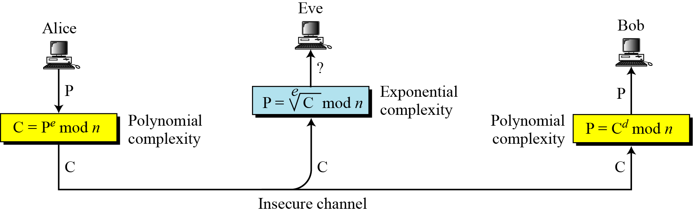
Complexity of operations in RSA

Slide 39
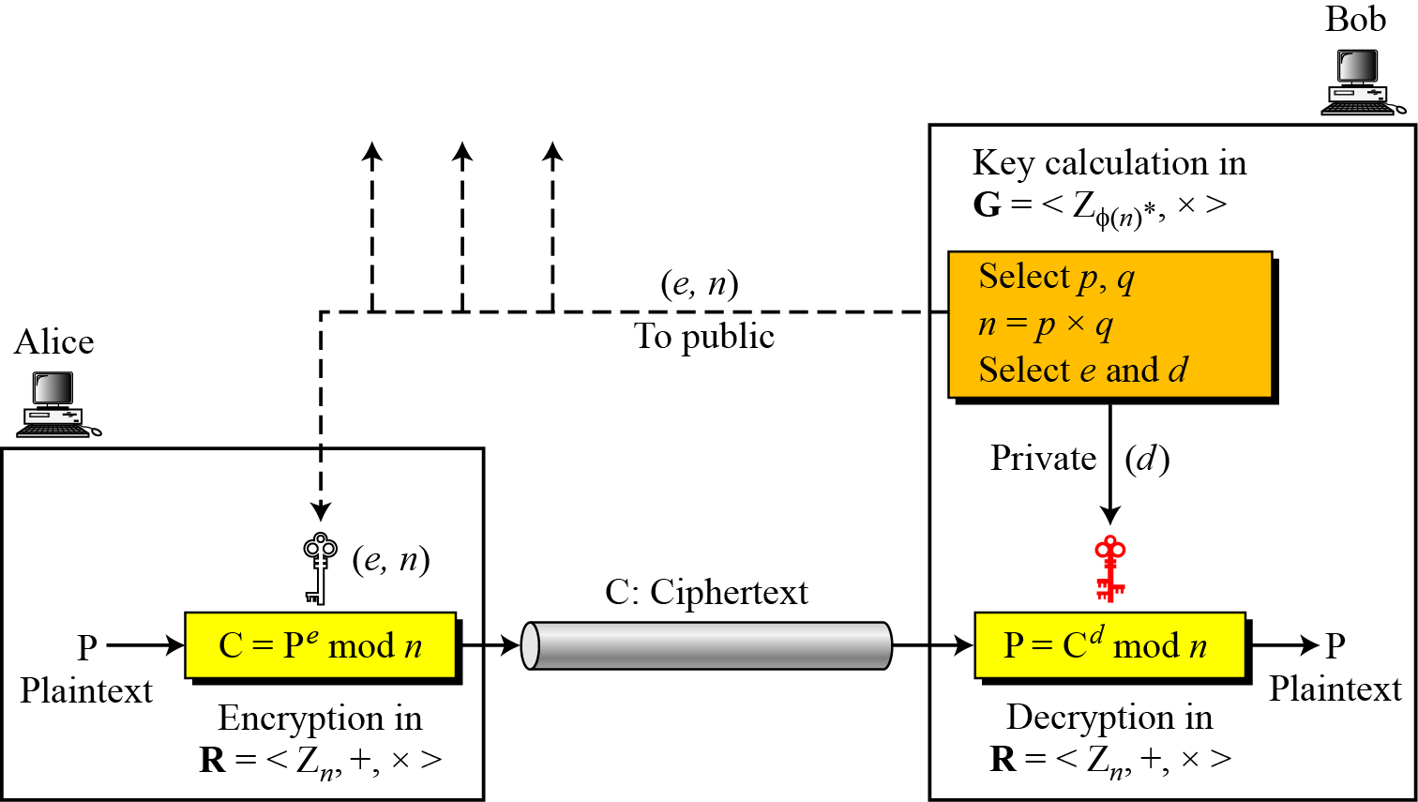
Encryption, decryption, and key generation in RSA

Slide 40
RSA: Choosing keys
1. Choose two large prime numbers p, q.
(e.g., 1024 bits each)
2. Compute n = pq, z = (p-1)(q-1)
3. Choose e (with e<n) that has no common factors
with z. (e, z are “relatively prime”).
4. Choose d such that ed-1 is exactly divisible by z.
(in other words: ed mod z = 1 ).
5. Public key is (n,e). Private key is (n,d).

Slide 41
RSA: Encryption, decryption
0. Given (n,b) and (n,a) as computed above
1. To encrypt bit pattern, m, compute
e
e
x = m mod n
(i.e., remainder when m is divided by n)
2. To decrypt received bit pattern, c, compute
d
d
m = x mod n
(i.e., remainder when c is divided by n)
Magic
happens!
e
d
m = (m mod n)
mod n
x

Slide 42
Some Trivial Examples
Bob chooses 7 and 11 as p and q and calculates n = 77. The value of φ(n) = (7 − 1)(11 − 1) or 60. Now he chooses two exponents, e and d, from Z₆₀∗. If he chooses e to be 13, then d is 37. Note that e × d mod 60 = 1 (they are inverses of each Now imagine that Alice wants to send the plaintext 5 to Bob. She uses the public exponent 13 to encrypt 5.
Bob receives the ciphertext 26 and uses the private key 37 to decipher the ciphertext:

Slide 43
Why RSA Works
Theorem (Correctness of RSA): (Me)^{d} ≡ M (mod n).
Proof:
By the definition of d, we know that de ≡ 1 [mod (p−1)(q−1)].
Thus by the definition of modular congruence,
∃k: de = 1 + k(p−1)(q−1).
So, the result of decryption is
C^{d} ≡ (Me)^{d} = Mde = M^{1+k(p−1)(q−1)} (mod n)

Slide 44
Proof cont.
We had:
C^{d} ≡ (Me)^{d} = Mde = M^{1+k(p−1)(q−1)} (mod n)
Assuming that M is not divisible by either p or q,
Which is nearly always the case when p and q are very large
Fermat’s Little Theorem tells us that
M^{p−1}≡1 (mod p) and M^{q−1}≡1 (mod q)
Thus, we have that the following two congruences hold:
First: C^{d} ≡ M · (M^{p−1})^{k(q−1)} ≡ M·1^{k(q−1)} ≡ M (mod p)
Second: C^{d} ≡ M·(M^{q−1})^{k(p−1)} ≡ M·1^{k(p−1)} ≡ M (mod q)
Hmm. System of modular equations…

Slide 45
Proof cont.
We had:
C^{d} ≡ (Me)^{d} = Mde = M^{1+k(p−1)(q−1)} (mod n)
Assuming that M is not divisible by either p or q,
Which is nearly always the case when p and q are very large
Fermat’s Little Theorem tells us that
M^{p−1}≡1 (mod p) and M^{q−1}≡1 (mod q)
Thus, we have that the following two congruences hold:
First: C^{d} ≡ M · (M^{p−1})^{k(q−1)} ≡ M·1^{k(q−1)} ≡ M (mod p)
Second: C^{d} ≡ M·(M^{q−1})^{k(p−1)} ≡ M·1^{k(p−1)} ≡ M (mod q)
Hmm. System of modular equations…

Slide 46
Proof cont.
Thus, we have that the following two congruences hold:
First: C^{d} ≡ M · (M^{p−1})^{k(q−1)} ≡ M·1^{k(q−1)} ≡ M (mod p)
Second: C^{d} ≡ M·(M^{q−1})^{k(p−1)} ≡ M·1^{k(p−1)} ≡ M (mod q)
Hmm. System of modular equations…
And since gcd(p,q) = 1, we can use the Chinese Remainder Theorem
to show that therefore C^{d} ≡ M (mod pq), since
If C^{d} ≡ M (mod pq) then ∃s: C^{d} = s p q + M,
so C^{d} ≡ M (mod p) and also C^{d} ≡ M (mod q).
Thus, M is a solution to these two congruences,
so (by CRT) it’s the only solution.
QED

Slide 47
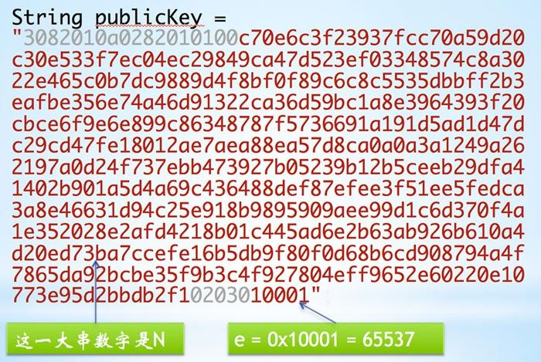
RSA Example

Slide 48
Key Size
Security (bits) | ECC-based scheme (size of n in bits) | RSA/DSA (modulus size in bits)
56 | 112 | 512
80 | 160 | 1024
112 | 224 | 2048
128 | 256 | 3072
192 | 384 | 7680
256 | 512 | 15360
Notes:
Stallings Table 10.3 - “ Comparable Key Sizes in Terms of Computational Effort for Cryptanalysis” illustrates the relative key sizes needed for security.

Slide 49
Elliptic Curve Cryptography
ECC addition is analog of modulo multiplication
ECC repeated addition is analog of modulo exponentiation
need “hard” problem equiv to discrete log
Q=kP, where Q,P belong to a prime curve
is “easy” to compute Q given k,P
but “hard” to find k given Q,P
known as the elliptic curve logarithm problem
Notes:
Elliptic Curve Cryptography uses addition as an analog of modulo multiply, and repeated addition as an analog of modulo exponentiation. The “hard” problem is the elliptic curve logarithm problem.

Slide 50
Elliptic Curves over Real Numbers
The general equation for an elliptic curve is
Elliptic curves over real numbers use a special class of elliptic curves of the form
where 4a^3 + 27b^2!=0
The left-hand side has a degree of 2 while the right-hand side has a degree of 3. This means that a horizontal line can intersects the curve in three points if all roots are real. However, a vertical line can intersects the curve at most in two points.

Slide 51

b = 1
a = 2 ~ -3

Slide 52
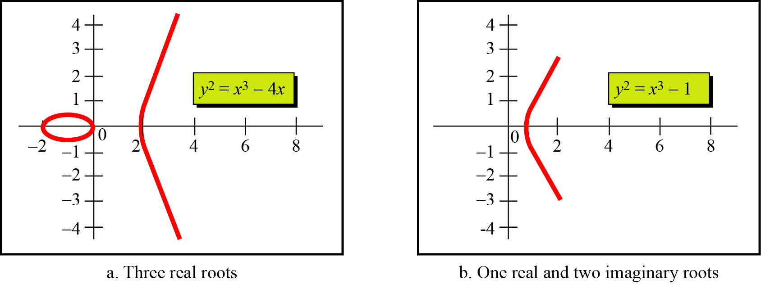
Elliptic Curves over Real Numbers
An Abelian (commutative) Group
All points on an elliptic curve. A tuple P(x1, y1) represents a point on the curve if x1 and y1 are coordinates of a point on the curve that satisfy the equation of the curve.
For example, the points P(2, 0), Q(0, 0), R(-2, 0), S(10, 30.98) are all points on the curve
Each point is represented by two real number.

Slide 53
Elliptic Curves over Real Numbers
Set
We define the set as the points on the curve, where each point is a pair of real numbers
E={(2, 0), (0, 0), (-2, 0), (10, 30.98) (10, -30.98)}
Operation
We can define an addition operation on the points of the curve. Addition operation is different from the integer addition.

Slide 54
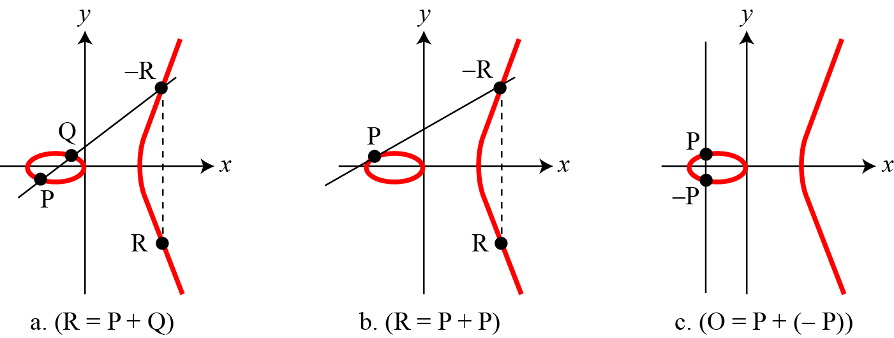
Continued
Three adding cases in an elliptic curve

Slide 55
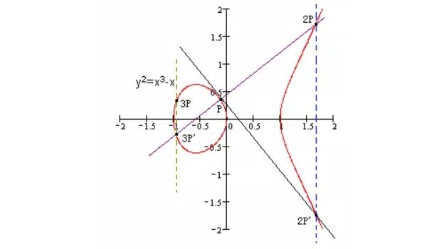
Multiplication
To compute KP

Slide 56
Example
Here is a very trivial example of encipherment using an elliptic curve over GF(p).
Bob selects an elliptic curve E over GF(p).
Bob selects e₁ = (2, 22) and d = 4.
Bob calculates e₂ = (13, 45), where e₂ = d × e₁.
Bob publicly announces the tuple (E, e₁, e₂).
Alice wants to send the plaintext P = (24, 26) to Bob. She selects r = 2.

Slide 57
6. Alice calculates C₁ = (35, 1), where C₁ = r × e₁
7. Alice calculates the point C₂ = (21, 44), where C₂ = P +r × e₂
8. Bob receives C₁ and C₂
9. Bob uses d on C₁ , d × C₁ to get (23,25)
10. Bob subtract C₂ by (23,25) to get (24, 26)
C₂ – d × C₁ = P + r × e₂ - d × ( r × e₁ )
= P + r × d × e₁ - d × ( r × e₁ )
= P

Slide 58
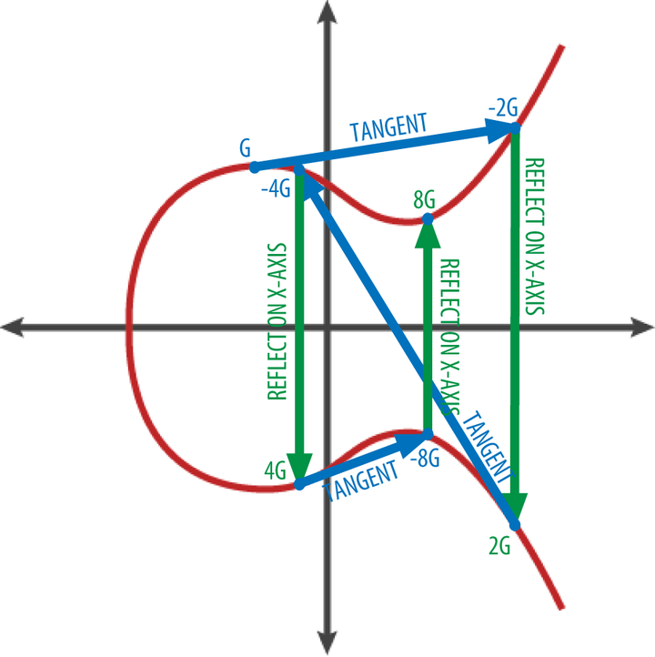
Fast multiplication
To compute 8G

